Slide 1
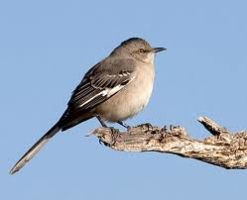
To Kill A Mockingbird - Introduction

Slide 2
Goals of Novel Unit
1. To Analyze Marking period theme
Hope
Essential Question:
How does one maintain a sense of hope in the face of unfairness and discrimination?
Students will write an essay demonstrating knowledge of theme/ Graded Benchmark

Slide 3
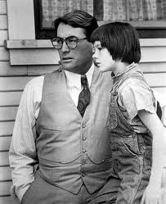
Goals
2. To understand effect of first –person omniscient narrator

Slide 4
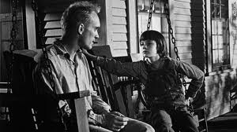
Goal – Understanding Symbolism
3. To explain the symbolism in the novel- What does it mean to “Kill a Mockingbird”?

Slide 5
Goal: To do a close reading of quotes from the book and explain their significance.
I wanted you to see what real courage is, instead of getting the idea that courage is a man with a gun in his hand. It's when you know you're licked before you begin but you begin anyway and you see it through no matter what. You rarely win, but sometimes you do. ~Harper Lee, To Kill a Mockingbird, Chapter 11, spoken by the character Atticus

Slide 6
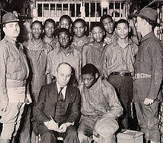
Goal: To read an historical account and determine how it influenced the plot of the novel
Non-fiction article “An Occurrence in Scottsboro, Alabama”

Slide 7
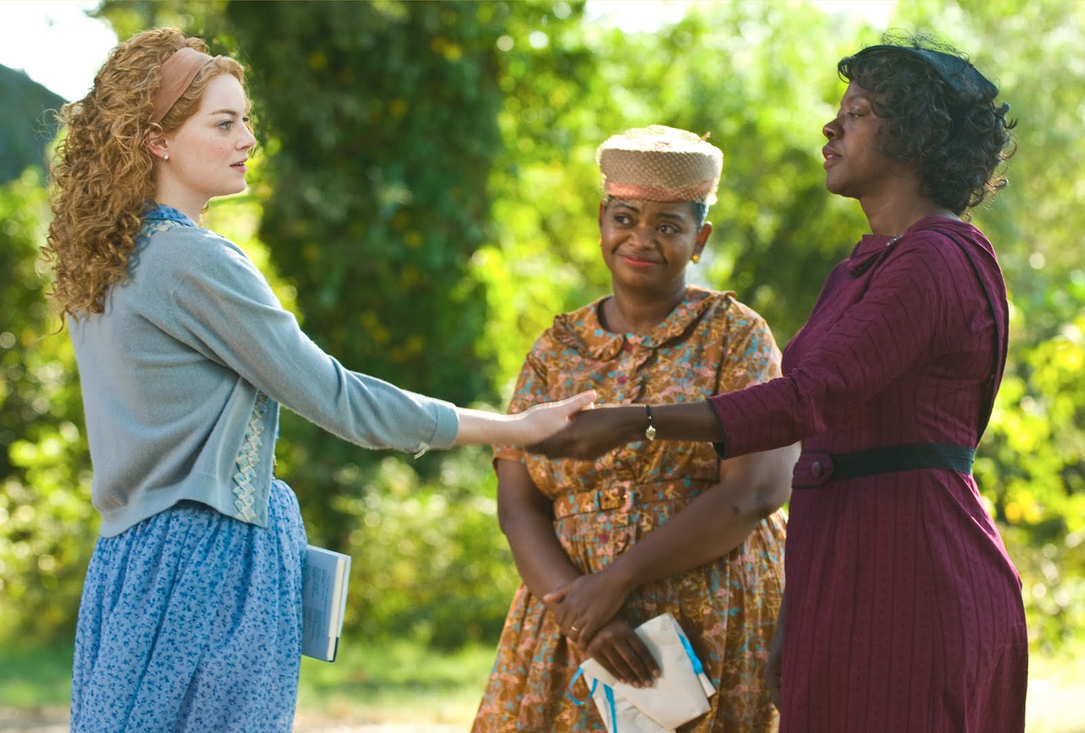
6. To compare and contrast themes of discrimination in To Kill A Mockingbird and The Help
I

Slide 8
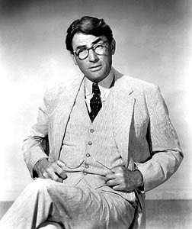
Characters
Lee used her hometown as the model for the setting of Maycomb, and used her friend and fellow author Truman Capote as the model for Dill.
Atticus was based on her own father, a lawyer, who had a good conscience and trip to confront racial injustice in the South.

Slide 9
Author – Harper Lee
Nelle Harper Lee (born 28 April 1926 in Monroeville, Alabama) is an American writer and Pulitzer Prize winner. She is best known for her book To Kill A Mockingbird.
Harper Lee was the youngest of four children of Frances Cunningham Finch Lee and Amasa Coleman Lee, a lawyer and state senator from Alabama and a descendant of the Southern General Robert E. Lee. She attended Huntingdon College (1944-1945), studied law at the University of Alabama (1945-1949) and spent a year at Oxford in England. Before her career as a writer, she worked during the 50's for some time at the counter of Eastern Airlines and BOAC in New York. She eventually left this job in order to completely devote herself to writing. In 1957 Harper Lee submitted a manuscript of short stories about life in the southern U.S. to the publishing house JB Lippincott & Co. There, working with her editor Tay Hohoff, she turned these into the novel To Kill A Mockingbird over the next two and a half years.
Her first and only book, To Kill a Mockingbird was released in 1960 and the following year it was awarded the Pulitzer Prize. By 1962 To Kill a Mockingbird was already being made into a movie with Gregory Peck in the role of Atticus Finch, for which he won an Oscar. The film received three Oscars in total.

Slide 10
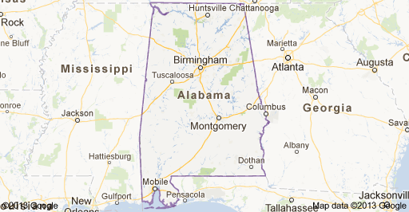
Setting

